Slide 1
Gradient Descent & ANN Anatomy
UIUC ECON 490: Applied Machine Learning in Economics

Slide 2
Gradient Descent
A method to approximately solve for coefficients

Slide 3
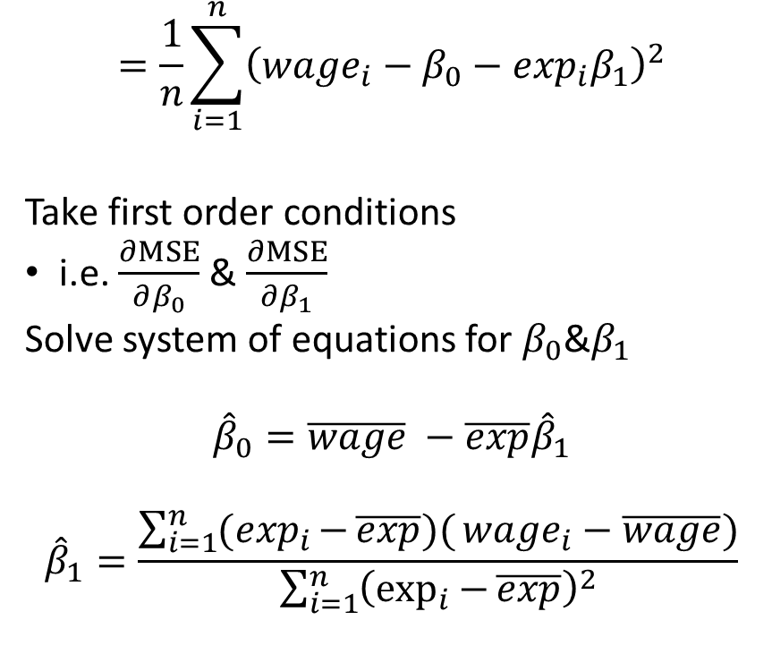
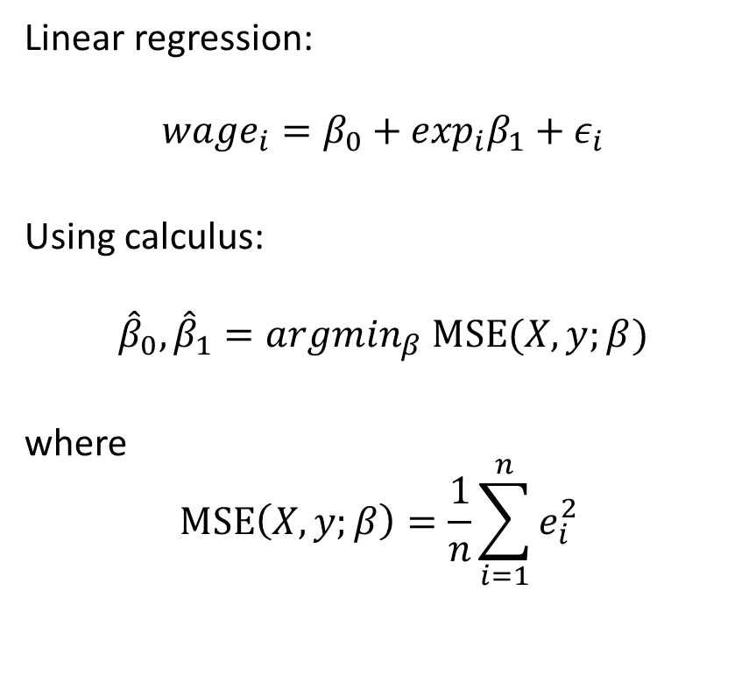
Linear regression has closed form solution via OLS
Linear regression:
$$wage_{i}=β_{0}+\exp_{i}β_{1}+ε_{i}$$
Using calculus:
$${\hat{β}}_{0}, {\hat{β}}_{1}=argmin_{β} MSE(X,y;β)$$
where
$$MSE\left(X,y;β\right)=\frac{1}{n}\sum_{i=1}^{n}{e_{i}^{2} }$$
$$=\frac{1}{n}\sum_{i=1}^{n}{{\left(wage_{i}−β_{0}−\exp_{i}β_{1}\right)}^{2}}$$
Take first order conditions
i.e. $\frac{∂MSE}{∂β_{0}}$ & $\frac{∂MSE}{∂β_{1}}$
Solve system of equations for $β_{0}$&$β_{1}$
$${\hat{β}}_{0}=\overline{wage} −\overline{exp}{\hat{β}}_{1}$$
$${\hat{β}}_{1}=\frac{\sum_{i=1}^{n}{(\exp_{i}{−}\overline{exp})(}wage_{i}−\overline{wage})}{\sum_{i=1}^{n}{{\left(\exp_{i}{−}\overline{exp}\right)}^{2}}}$$

Slide 4
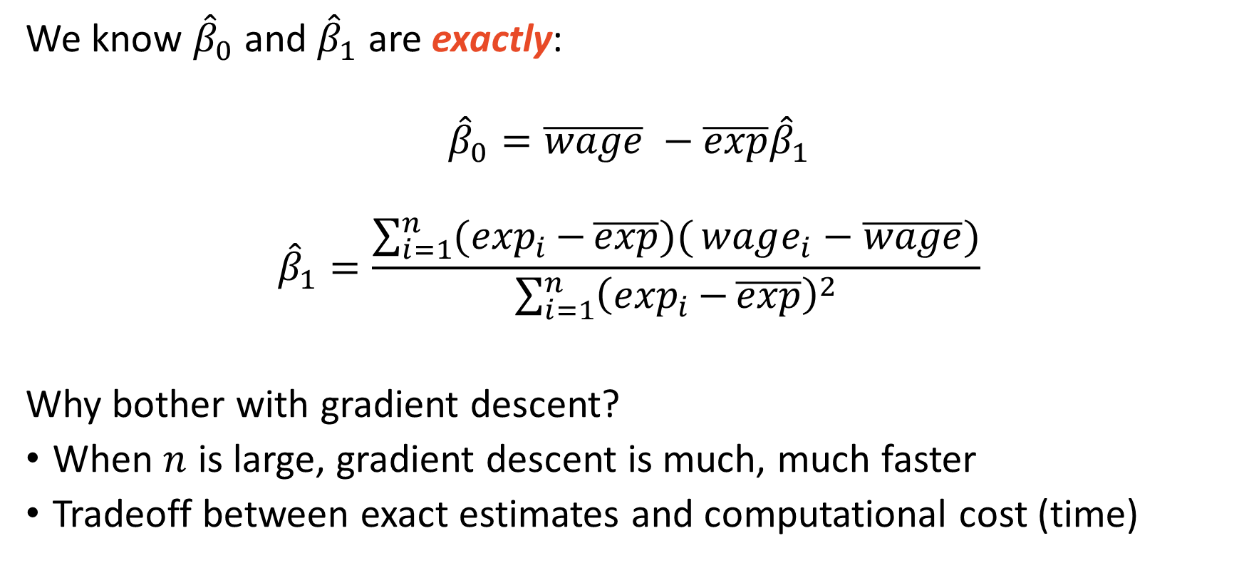
Gradient descent can be used for OLS
We know ${\hat{β}}_{0}$ and ${\hat{β}}_{1}$ are exactly:
$${\hat{β}}_{0}=\overline{wage} −\overline{exp}{\hat{β}}_{1}$$
$${\hat{β}}_{1}=\frac{\sum_{i=1}^{n}{(\exp_{i}{−}\overline{exp})(}wage_{i}−\overline{wage})}{\sum_{i=1}^{n}{{\left(\exp_{i}{−}\overline{exp}\right)}^{2}}}$$
Why bother with gradient descent?
When $n$ is large, gradient descent is much, much faster
Tradeoff between exact estimates and computational cost (time)

Slide 5
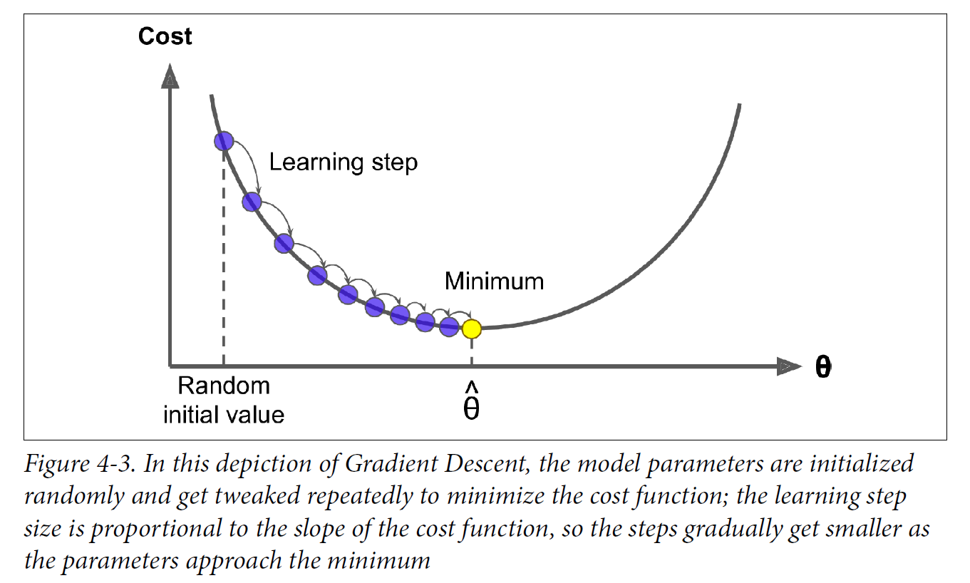
Gradient descent obtains $\hat{β}$ at the limit given $η$

Slide 6
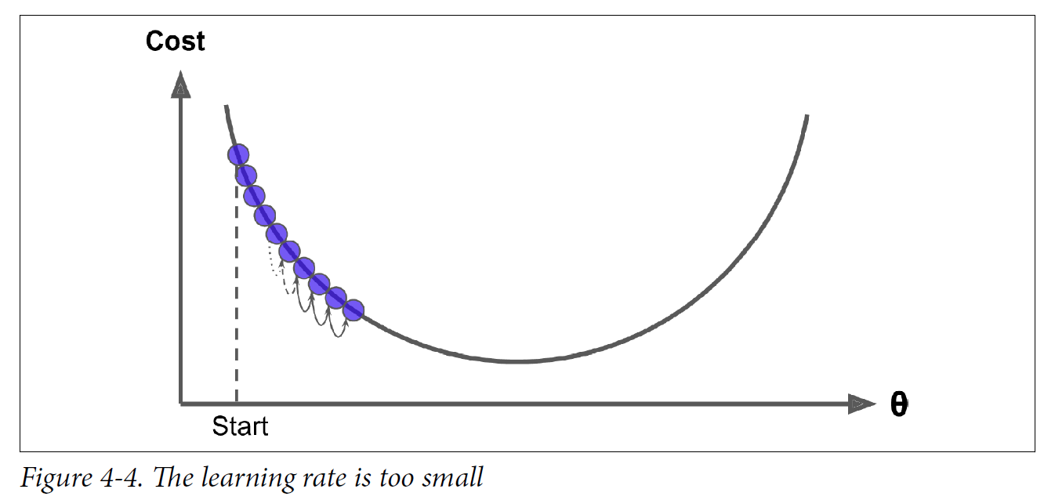
If $η$ is too small, convergence is slow

Slide 7
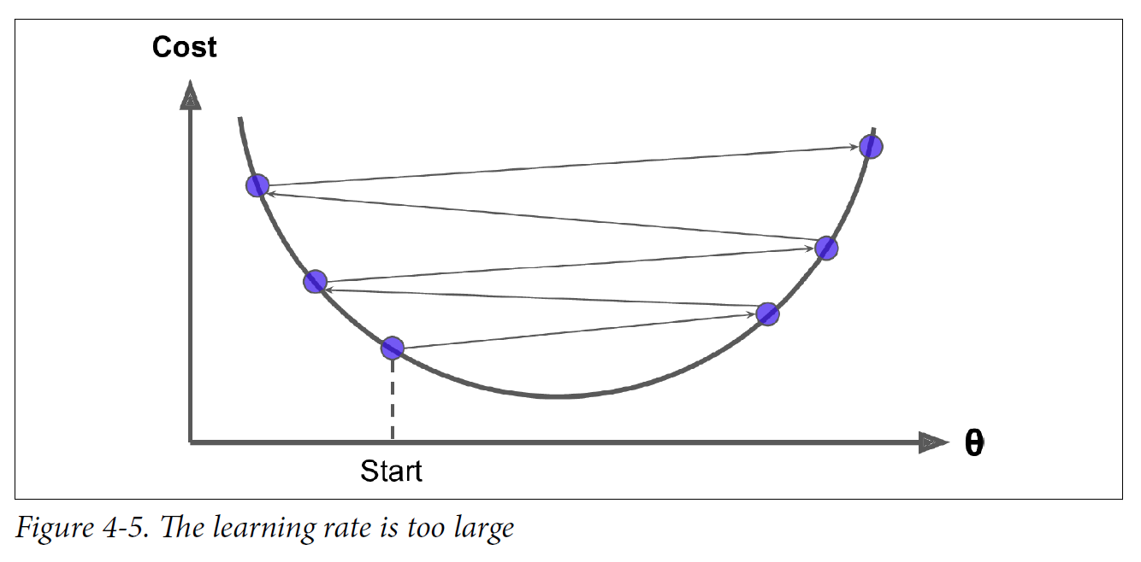
A too large $η$ will diverge

Slide 8
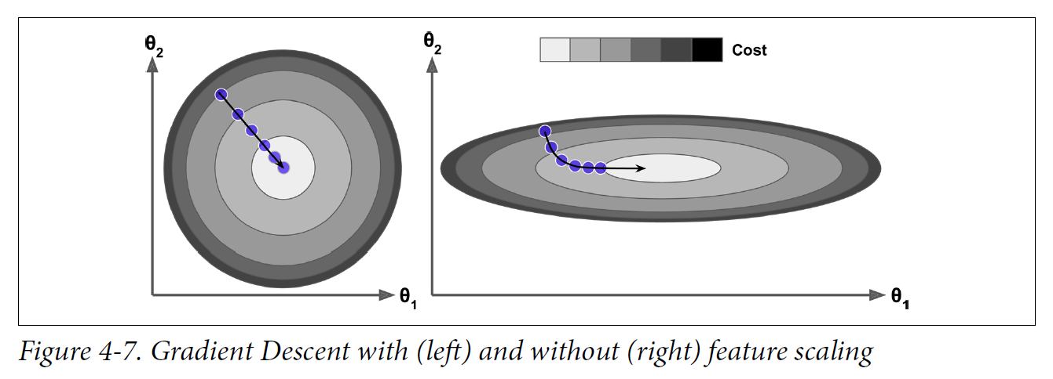
Non-scaled data take longer to estimate

Slide 9
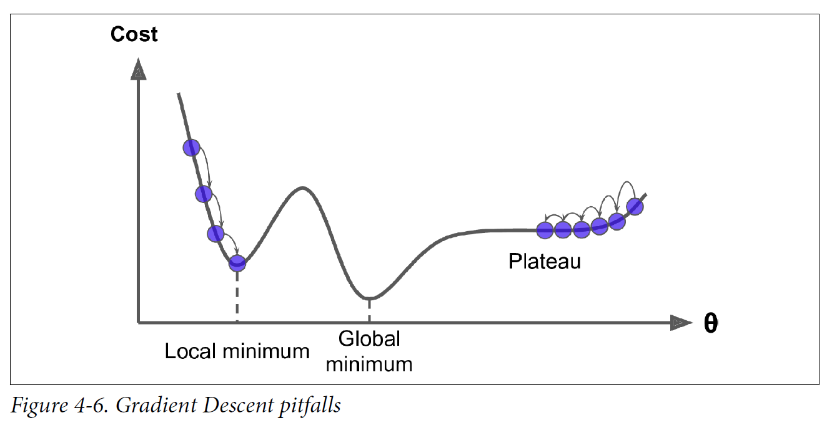
Other cost functions may not be convex (bowl)

Slide 10
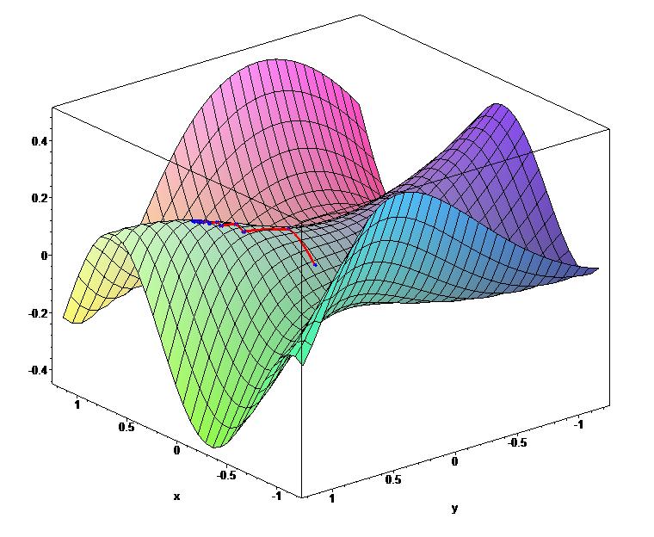
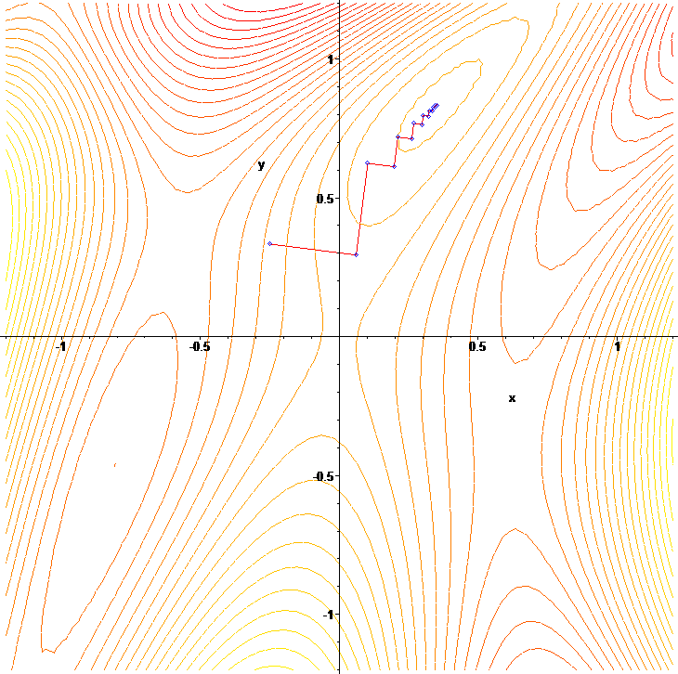
Gradient descent for two coefficients
Source: Wikipedia – Gradient Descent

Slide 11
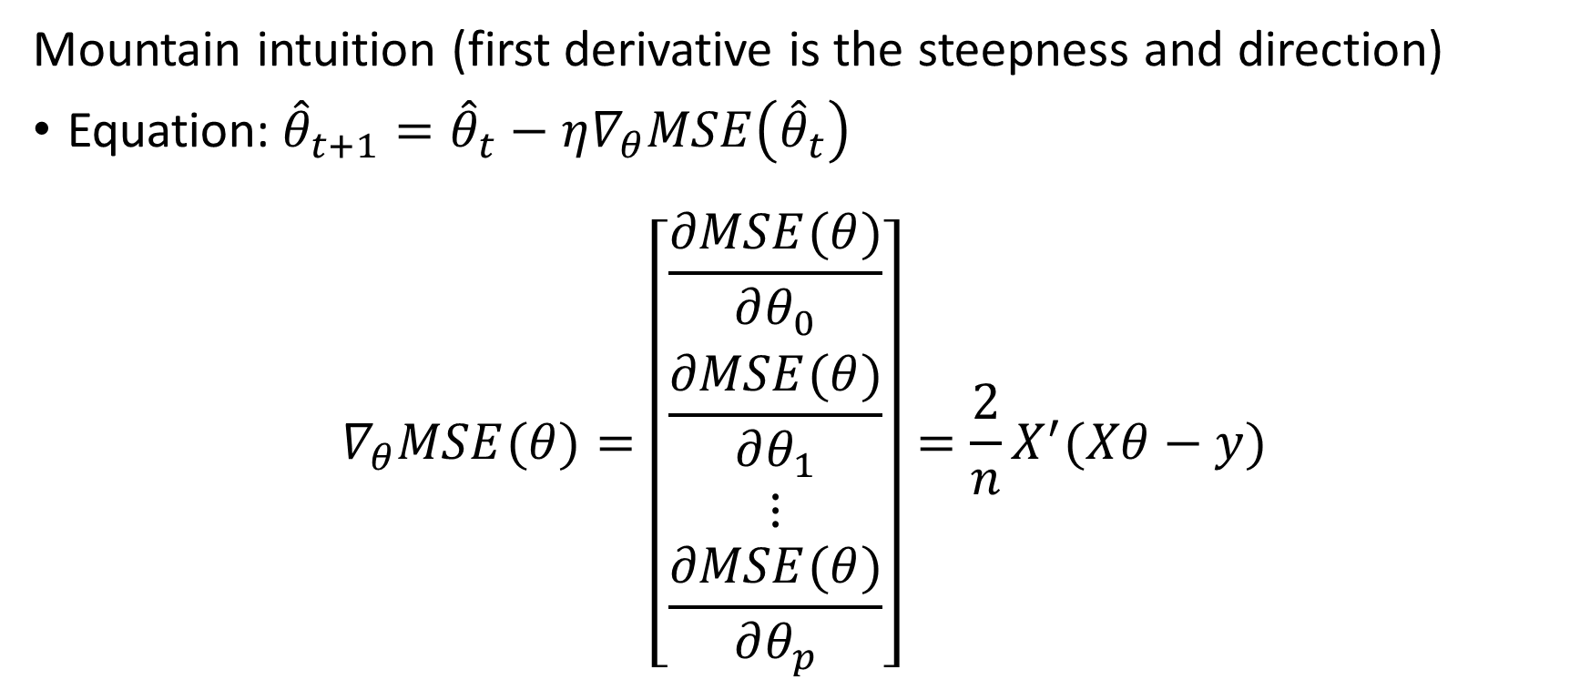
Mechanics of gradient descent are straightforward
Mountain intuition (first derivative is the steepness and direction)
Equation:${\hat{θ}}_{t+1}={\hat{θ}}_{t}−η∇_{θ}MSE\left({\hat{θ}}_{t}\right)$
$$∇_{θ}MSE(θ)=\left[\begin{matrix}\frac{∂MSE(θ)}{∂θ_{0}} \\ \frac{∂MSE(θ)}{∂θ_{1}} \\ ⋮ \\ \frac{∂MSE(θ)}{∂θ_{p}}\end{matrix}\right]=\frac{2}{n}X^{′}(Xθ−y)$$

Slide 12
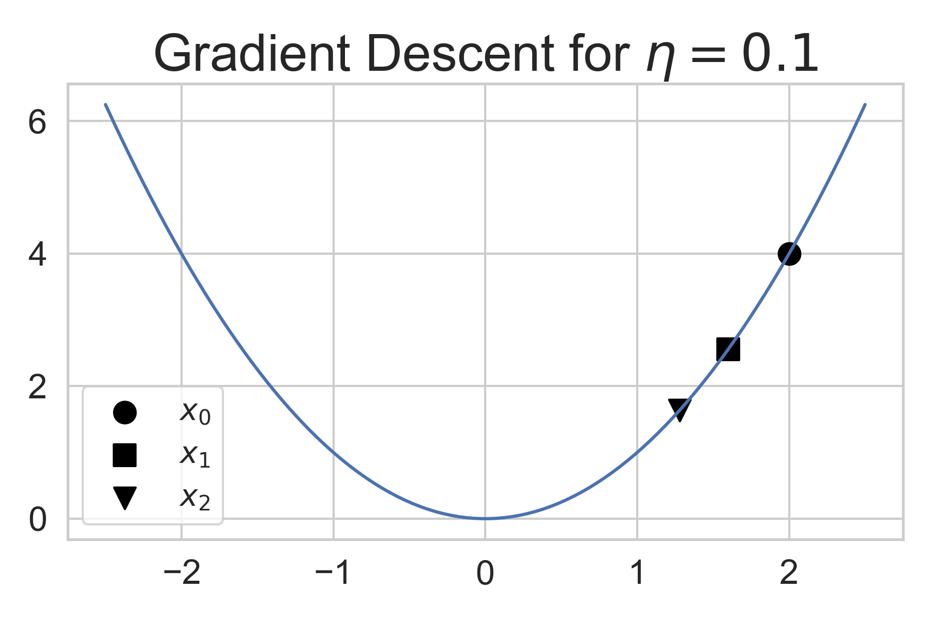
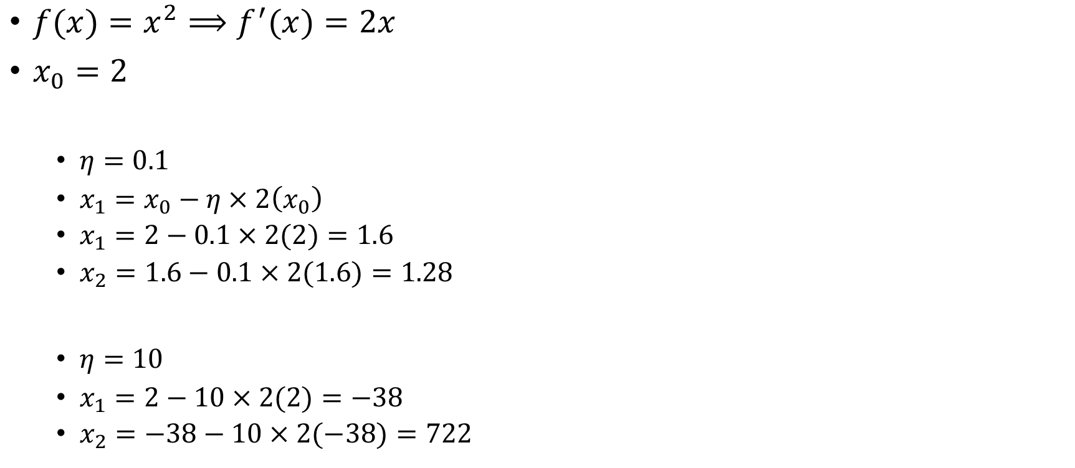
Univariate Example ${\hat{θ}}_{t+1}={\hat{θ}}_{t}−η∇_{θ}MSE\left({\hat{θ}}_{t}\right)$
$f(x)=x^{2}⟹f^{′}(x)=2x$
$x_{0}=2$
$η=0.1$
$x_{1}=x_{0}−η×2\left(x_{0}\right)$
$x_{1}=2−0.1×2(2)=1.6$
$x_{2}=1.6−0.1×2(1.6)=1.28$
$η=10$
$x_{1}=2−10×2(2)=−38$
$x_{2}=−38−10×2(−38)=722$

Slide 13
The three primary types of gradient descent
Batch gradient descent
Extremely large training data per update
Stochastic gradient descent (SGD)
Extremely small training data per update
Mini-batch gradient descent
Balance of SGD and batch gradient descent

Slide 14
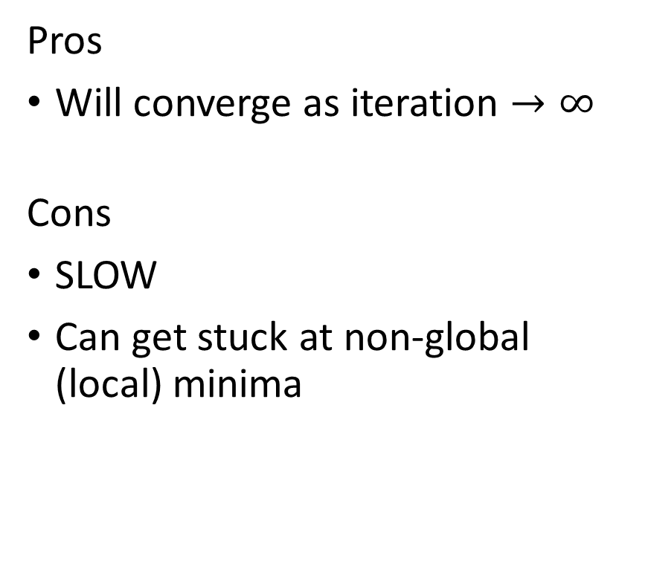
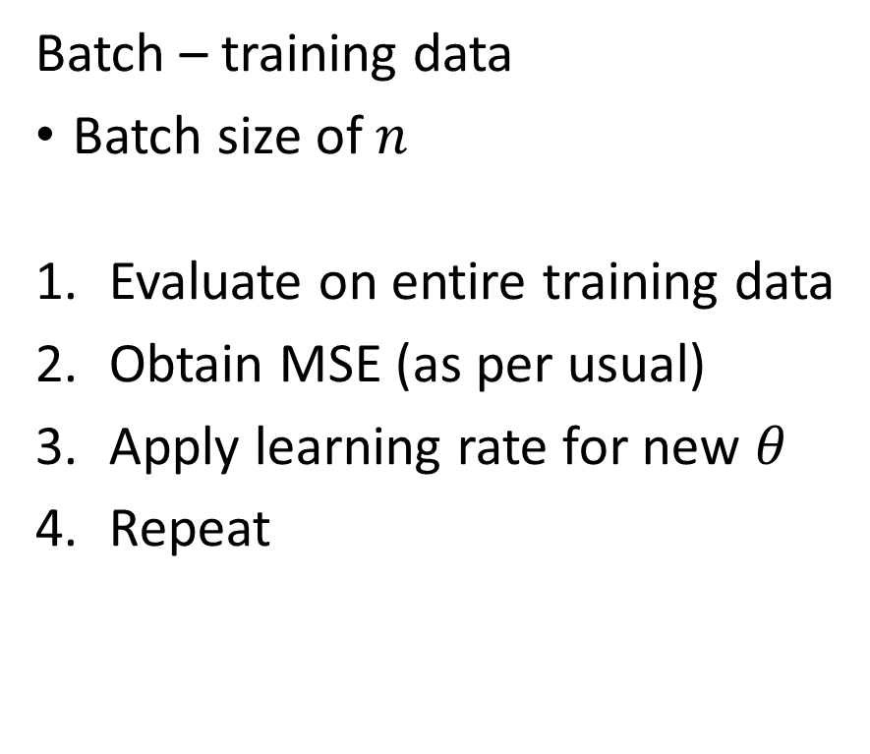
Batch Gradient Descent
Batch – training data
Batch size of $n$
Evaluate on entire training data
Obtain MSE (as per usual)
Apply learning rate for new $θ$
Repeat
Pros
Will converge as iteration $→∞$
Cons
SLOW
Can get stuck at non-global (local) minima

Slide 15
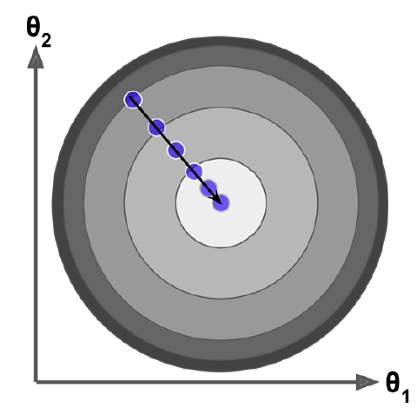
Batch gradient descent cost function

Slide 16
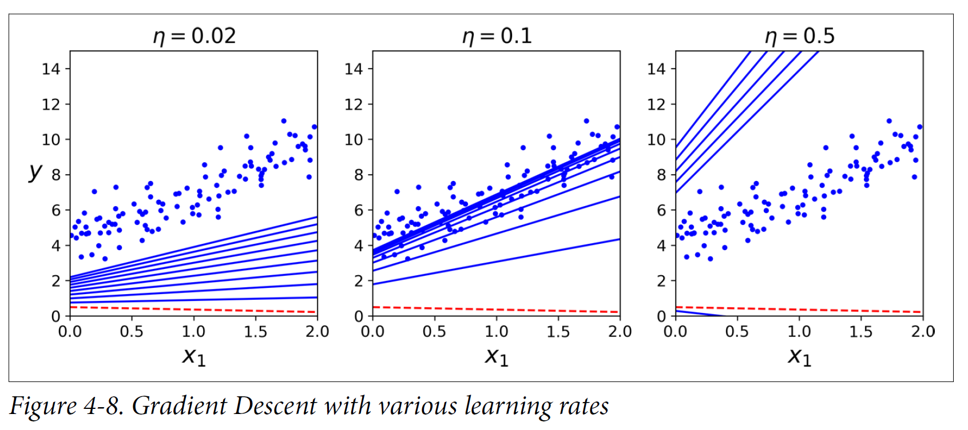
Batch gradient descent linear regression

Slide 17
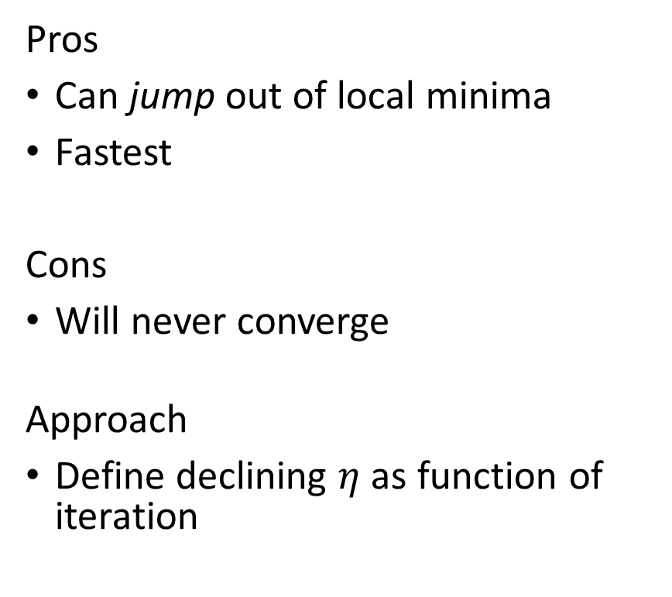
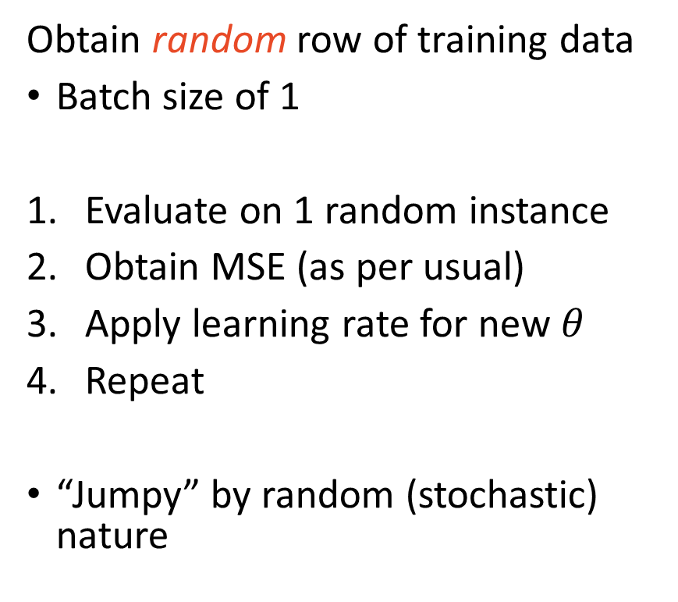
Stochastic Gradient Descent
Obtain random row of training data
Batch size of 1
Evaluate on 1 random instance
Obtain MSE (as per usual)
Apply learning rate for new $θ$
Repeat
“Jumpy” by random (stochastic) nature
Pros
Can jump out of local minima
Fastest
Cons
Will never converge
Approach
Define declining $η$ as function of iteration

Slide 18
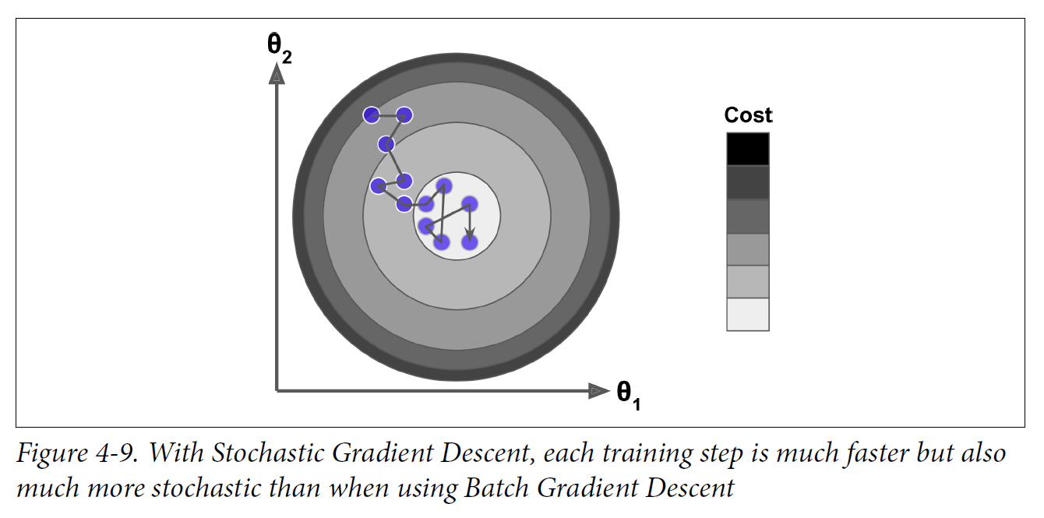
Stochastic gradient descent cost function

Slide 19
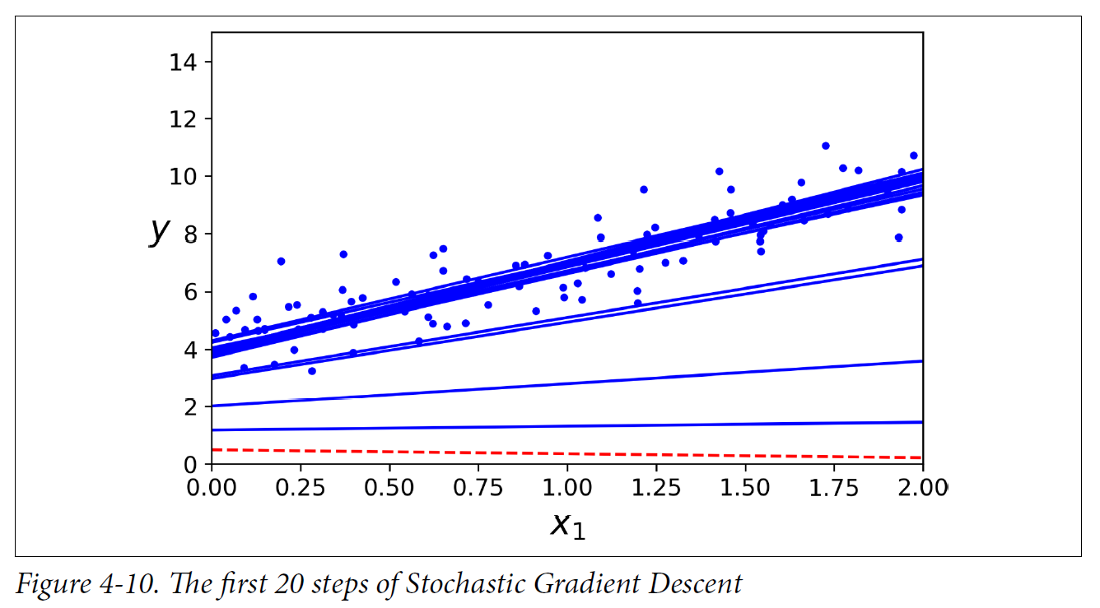
Stochastic gradient descent linear regression

Slide 20
Mini-batch Gradient Descent
Obtain random batch of data
Analogous to cross-validation
Balance of BGD & SGD
Batch (folds) use 16 – 96
Pros
Can escape local minima
Never converges but closer than SGD
Stable
Fast

Slide 21
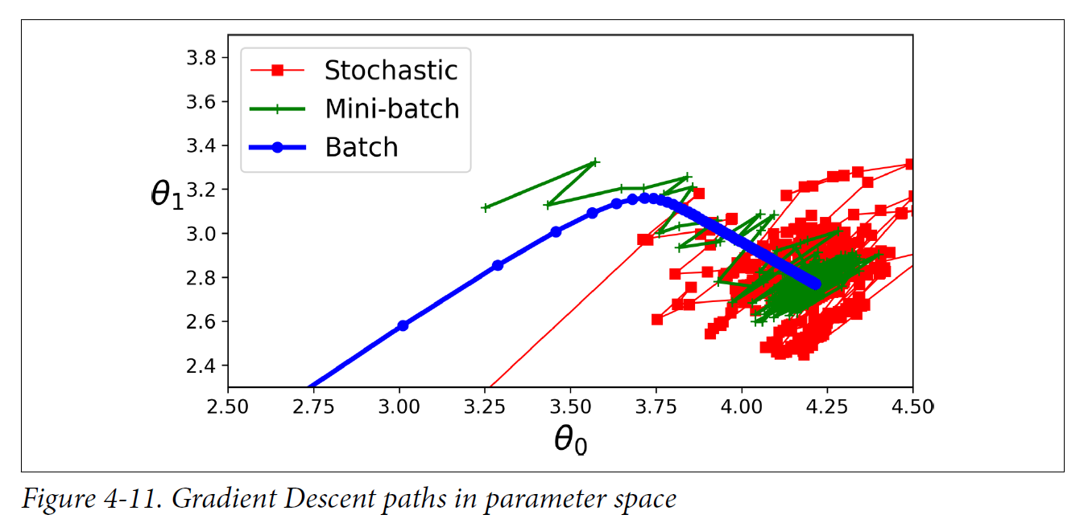
Gradient descent convergence comparison

Slide 22
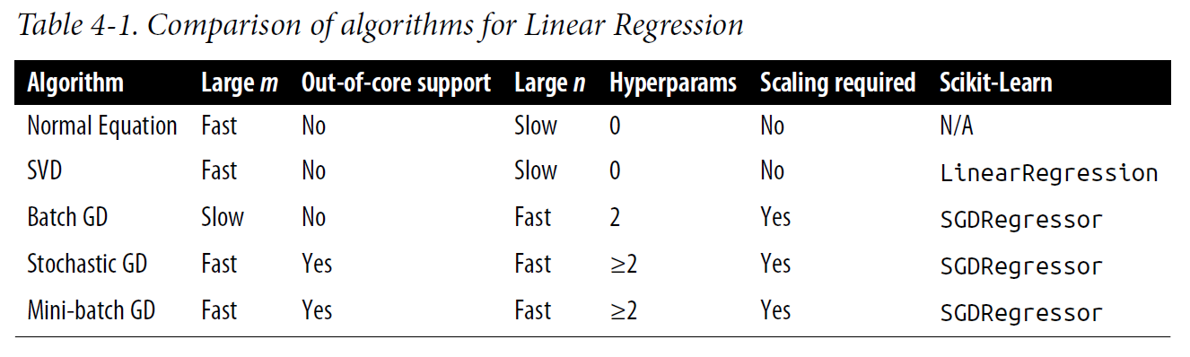
Fitting linear regression

Slide 23
Implementation: Scikit-learn
READ THE DOCUMENTATION FOR PARAMETERS
sklearn.linear_model.SGDRegressor()
loss =
‘squared_loss’ – Linear Regression
‘epsilon_insensitive’ – Linear SVR
sklearn.linear_model.SGDClassifier()
loss =
‘log’ – Logit
‘hinge’ – Linear SVC

Slide 24
Artificial Neural Networks
The moment you have been waiting for!

Slide 25

Biological Neurons

Slide 26
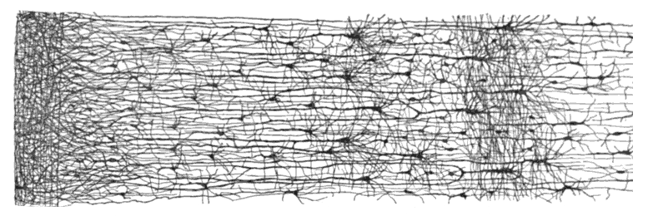
Neurons that Wire Together, Fire Together

Slide 27
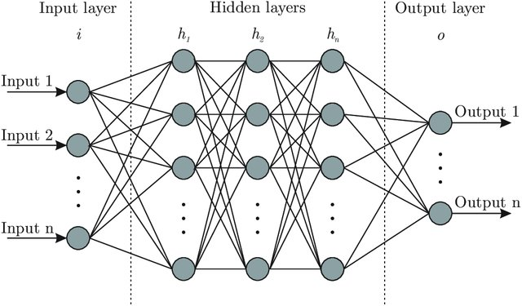
Neural Network Anatomy

Slide 28
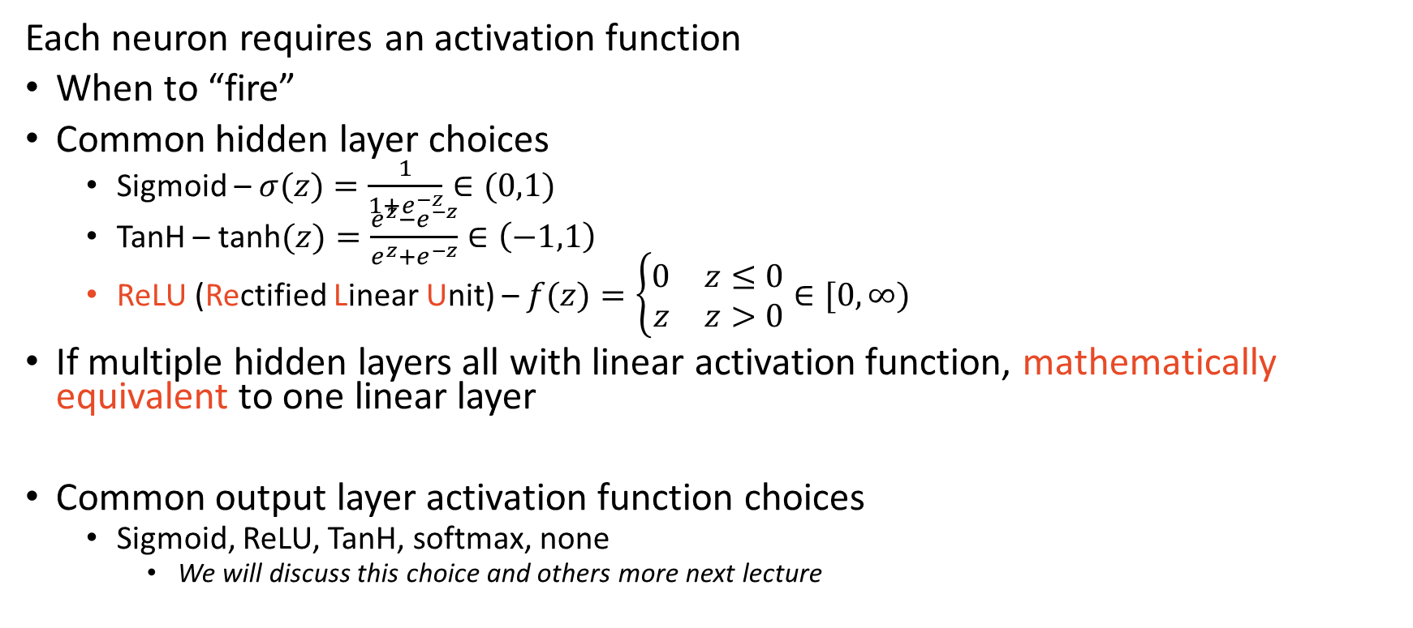
Neural Network – Hidden & Output Layers
Each neuron requires an activation function
When to “fire”
Common hidden layer choices
Sigmoid – $σ(z)=\frac{1}{1+e^{−z}}∈(0,1)$
TanH – $\text{tanh}(z)=\frac{e^{z}−e^{−z}}{e^{z}+e^{−z}}∈\left(−1,1\right)$
ReLU (Rectified Linear Unit) – $f(z)=\left\{\begin{matrix}0 & z≤0 \\ z & z>0\end{matrix}\right.∈[0,∞)$
If multiple hidden layers all with linear activation function, mathematically equivalent to one linear layer
Common output layer activation function choices
Sigmoid, ReLU, TanH, softmax, none
We will discuss this choice and others more next lecture

Slide 29
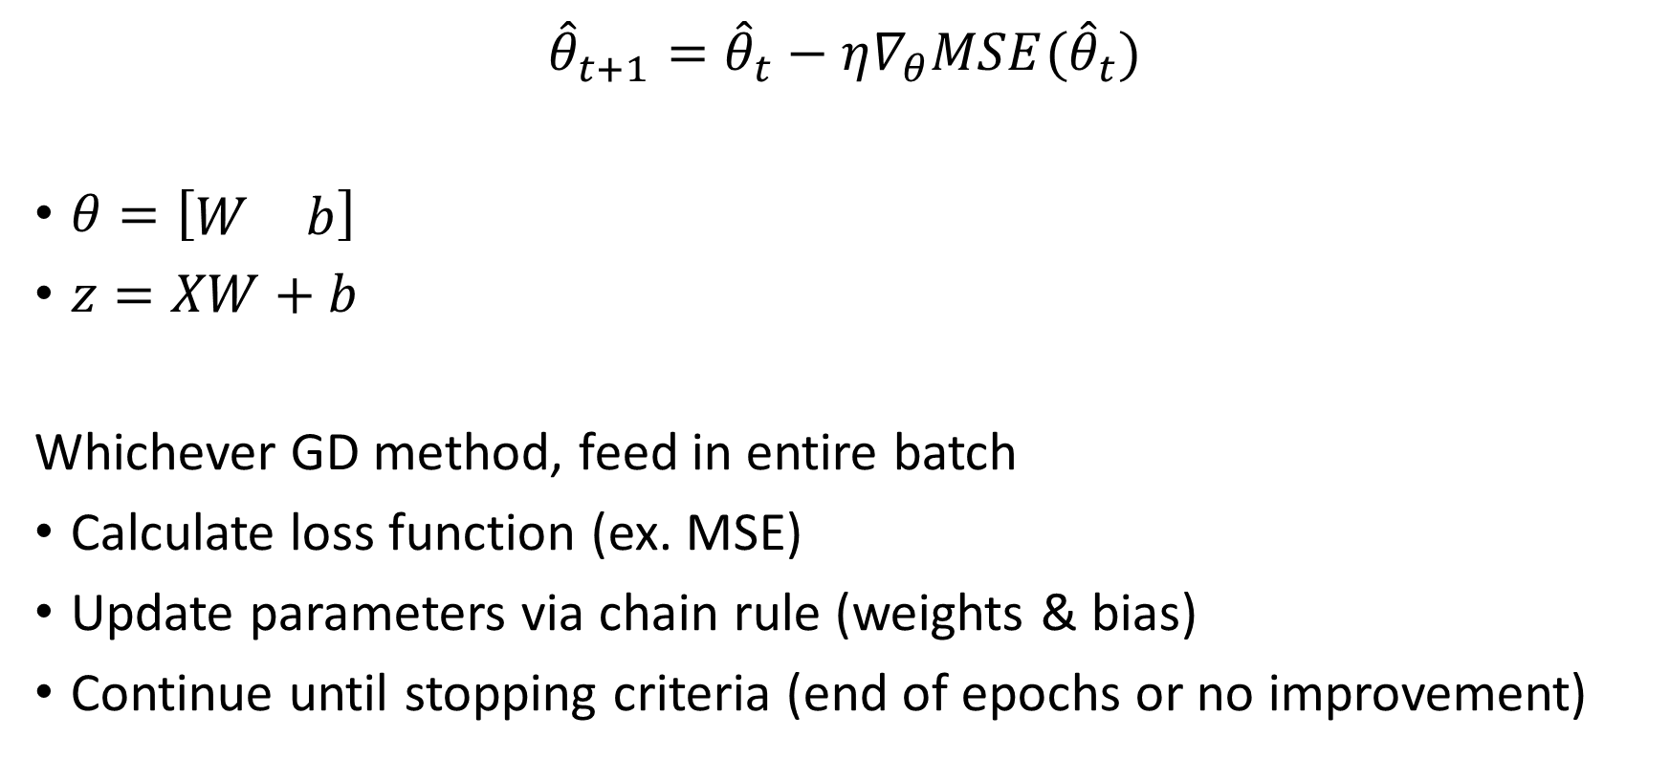
Feedforward NN & Back-propagation
$${\hat{θ}}_{t+1}={\hat{θ}}_{t}−η∇_{θ}MSE({\hat{θ}}_{t})$$
$θ=\left[\begin{matrix}W & b\end{matrix}\right]$
$z=XW+b$
Whichever GD method, feed in entire batch
Calculate loss function (ex. MSE)
Update parameters via chain rule (weights & bias)
Continue until stopping criteria (end of epochs or no improvement)

Slide 30
Main Takeaways
Gradient descent can be used to fit most algorithms
Gradient descent is useful for large data sets
Feature units affect cost function – standardize
Neural Networks are a bunch of transformed linear regressions

